Slide 1


This is your presentation title

Slide 2



DEPENDENCY INJECTION
IN .NET 5
BHRUGEN PATEL
www.bhrugen.com

Slide 4


DEPENDENCY INJECTION
DI is an integral part of ASP.NET Core (.NET 5)
Dependency injection is a form of IoC (Inversion of Control)
Dependency Injection is the fifth principle of S.O.L.I.D

Slide 5
DEPENDENCY INJECTION
Built-in IoC Container
The built-in container is represented by IServiceProvider
Types of service in ASP.NET Core (.NET 5)
Framework Services
Application Services

Slide 6
Framework Services
SERVICE TYPE | LIFETIME
IWebHostEnvironment | Singleton | Environment, hosting path etc.
Microsoft.Extensions.Logging.ILogger<T> | Singleton | Logging
Microsoft.Extensions.Logging.ILoggerFactory | Singleton | Logging
Microsoft.AspNetCore.Http.IHttpContextFactory | Transient | Context with request/response
Microsoft.Extensions.Options.IOptions<TOptions> | Singleton | Appsettings
Microsoft.AspNetCore.Hosting.IStartup | Singleton | Startup app configuration
Microsoft.AspNetCore.Hosting.Builder.IApplicationBuilderFactory | Transient | Appbuilder

Slide 7
Tools Needed
Visual Studio 2019 / Visual Studio Preview 2019
SQL Server 2017/2019
.NET 5 or .NET Core 3.1 ( will work with older versions as well)

Slide 8
Topics Covered
Benefits of dependency injection.
Framework & Application Services.
Service Lifetimes.
Middleware, constructor, view & middleware Injection.
Add/remove/replace service registration.
Multiple registrations.
Multiple implementations.

Slide 9
Create Project

Slide 10
IoC Container
Home
Controller
IOC Container
Service 1
Service 2
Some View
Market Forecaster
Some Middleware

Slide 11
IoC Container
Home
Controller
IOC Container
Service 1
Service 2
Market Forecaster
Some View
Market Forecaster
Service 1
Market Forecaster
Some Middleware

Slide 12
IOptions

Slide 13

NuGet Package

Slide 14
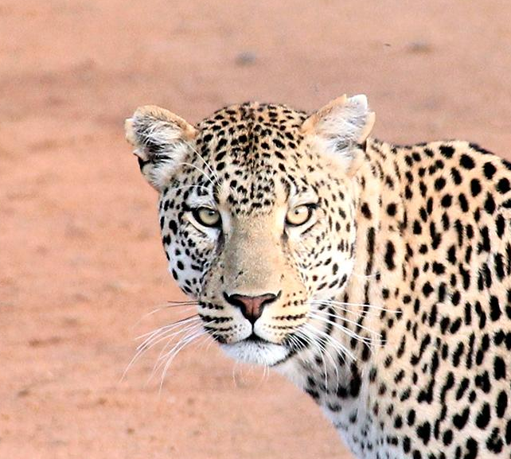
Hello!
I am Jayden Smith
I am here because I love to give presentations.
You can find me at @username

Slide 15
Project Creation

Slide 16
Service Lifetime
Singleton
Same instance for the life of application (unless restarted).
Scoped
Same Instance for one scope (one request in most cases).
Transient
Different instance every time the service is injected.

Slide 17
Singleton Lifetime
Syntax to Register : services.AddSingleton<>
Should be used very carefully.
Singleton service sends same instance for the life of the application.
E.g. If you click on all view or link on a website, whenever an instance is requested it will send same object. It will change only when application restarts.

Slide 18
Scoped Lifetime
Syntax to Register : services.AddScoped<>
Not ideal for multi-threading
Scoped service sends a new instance for each request.
E.g. If you click on a view or link for that page load if instance is requested 10 times it will send same object!

Slide 19
Transient Lifetime
Syntax to Register : services.AddTransient<>
Always try to register a service as transient if unsure.
Transient service sends a new instance every time it is requested.
E.g. If you click on a view or link for that page load if instance is requested 10 times it will send 10 different objects!

Slide 20
Quotations are commonly printed as a means of inspiration and to invoke philosophical thoughts from the reader.

Slide 21
This is a slide title
Here you have a list of items
And some text
But remember not to overload your slides with content
Your audience will listen to you or read the content, but won’t do both.

Slide 22
You can also split your content
White
Is the color of milk and fresh snow, the color produced by the combination of all the colors of the visible spectrum.
Black
Is the color of coal, ebony, and of outer space. It is the darkest color, the result of the absence of or complete absorption of light.

Slide 23
In two or three columns
Yellow
Is the color of gold, butter and ripe lemons. In the spectrum of visible light, yellow is found between green and orange.
Blue
Is the colour of the clear sky and the deep sea. It is located between violet and green on the optical spectrum.
Red
Is the color of blood, and because of this it has historically been associated with sacrifice, danger and courage.

Slide 24

A picture is worth a thousand words
A complex idea can be conveyed with just a single still image, namely making it possible to absorb large amounts of data quickly.

Slide 25
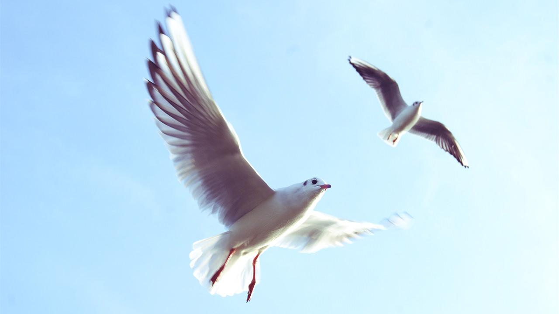
Want big impact?
Use big image.

Slide 26
Service Lifetime
Singleton
Same for the Entire Application
Gray
Black

Slide 27
And tables to compare data
 | A | B | C
Yellow | 10 | 20 | 7
Blue | 30 | 15 | 10
Orange | 5 | 24 | 16

Slide 28
Maps
our office

Slide 29
89,526,124
Whoa! That’s a big number, aren’t you proud?

Slide 30
89,526,124$
185,244 users
100%
That’s a lot of money
And a lot of users
Total success!

Slide 31
Our process is easy
first
second
last

Slide 32
Our sales funnel
20%
40%
60%
80%
100%

Slide 33
Let’s review some concepts
Yellow
Is the color of gold, butter and ripe lemons. In the spectrum of visible light, yellow is found between green and orange.
Blue
Is the colour of the clear sky and the deep sea. It is located between violet and green on the optical spectrum.
Red
Is the color of blood, and because of this it has historically been associated with sacrifice, danger and courage.
Yellow
Is the color of gold, butter and ripe lemons. In the spectrum of visible light, yellow is found between green and orange.
Blue
Is the colour of the clear sky and the deep sea. It is located between violet and green on the optical spectrum.
Red
Is the color of blood, and because of this it has historically been associated with sacrifice, danger and courage.

Slide 34
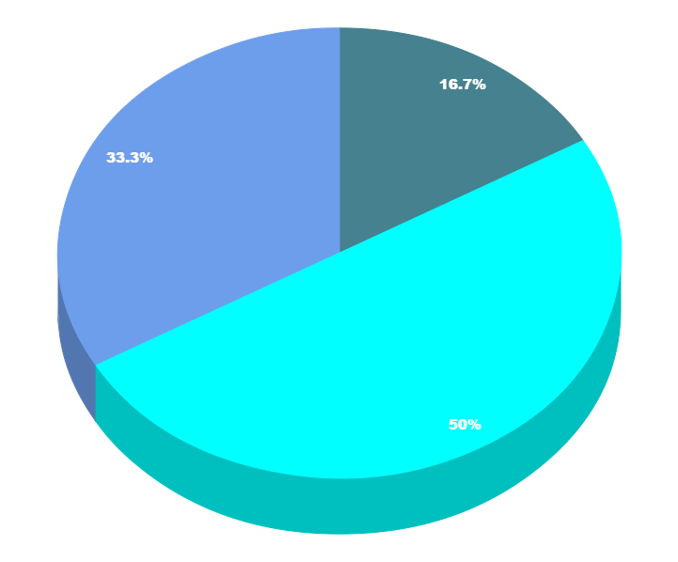
You can copy&paste graphs from Google Sheets

Slide 35
Place your screenshot here
Android project
Show and explain your web, app or software projects using these gadget templates.

Slide 36
Place your screenshot here
iPhone project
Show and explain your web, app or software projects using these gadget templates.

Slide 37
Place your screenshot here
Tablet project
Show and explain your web, app or software projects using these gadget templates.

Slide 38
Place your screenshot here
Desktop project
Show and explain your web, app or software projects using these gadget templates.

Slide 39
Thanks!
Any questions?
You can find me at:
@username
user@mail.me

Slide 40
Credits
Special thanks to all the people who made and released these awesome resources for free:
Presentation template by SlidesCarnival
Photographs by Unsplash

Slide 41
Presentation design
This presentation uses the following typographies and colors:
Titles: Nixie One
Body copy: Muli
You can download the fonts on this page:
https://www.fontsquirrel.com/fonts/nixie-one
https://www.fontsquirrel.com/fonts/muli
Aquamarina #00e1c6 / Turquoise #19bbd5 / Skyblue #2c9dde /
Light gray #c6daec / Dark blue #0e293c
You don’t need to keep this slide in your presentation. It’s only here to serve you as a design guide if you need to create new slides or download the fonts to edit the presentation in PowerPoint®

Slide 42
SlidesCarnival icons are editable shapes.
This means that you can:
Resize them without losing quality.
Change fill color and opacity.
Change line color, width and style.
Isn’t that nice? :)
Examples:

Slide 43
😉
Now you can use any emoji as an icon!
And of course it resizes without losing quality and you can change the color.
How? Follow Google instructions https://twitter.com/googledocs/status/730087240156643328
✋👆👉👍👤👦👧👨👩👪💃🏃💑❤😂😉😋😒😭👶😸🐟🍒🍔💣📌📖🔨🎃🎈🎨🏈🏰🌏🔌🔑 and many more...

Slide 44

Free templates for all your presentation needs
For PowerPoint and Google Slides
100% free for personal or commercial use
Ready to use, professional and customizable
Blow your audience away with attractive visuals

